Slide 1
Smart Bite
Mahmoud Samer 231006523
Rawan Atef 231005789
Retaj Ali 231005689
Rokaya Hamdy 231006586
Youssef Karim 231014449
Youssef Mahmoud 231006058

Slide 2
Problem Statement
Many users struggle with daily meal decisions due to limited cooking knowledge, difficulty matching recipes to the ingredients they already have, time constraints, rising food costs, and the need for healthier eating habits. This often leads to food waste, dependence on eating out, and inefficient meal planning. Smart Bite addresses these challenges by using AI and camera-based ingredient detection to transform available kitchen items into practical, cost-effective, and nutritious meals—helping students, busy individuals, and families cook smarter with what they already have.

Slide 3
Stakeholders
End Users | Use the app to input ingredients, browse recipes, save favourites, manage subscriptions
Investors | Provide funding, monitor project progress
Recipe database | Store and organize recipes, provide data to AI for suggestions
Advertisers | Display targeted ads to users, generate revenue
AI Model | Process user input, generate personalized recipe suggestions

Slide 4
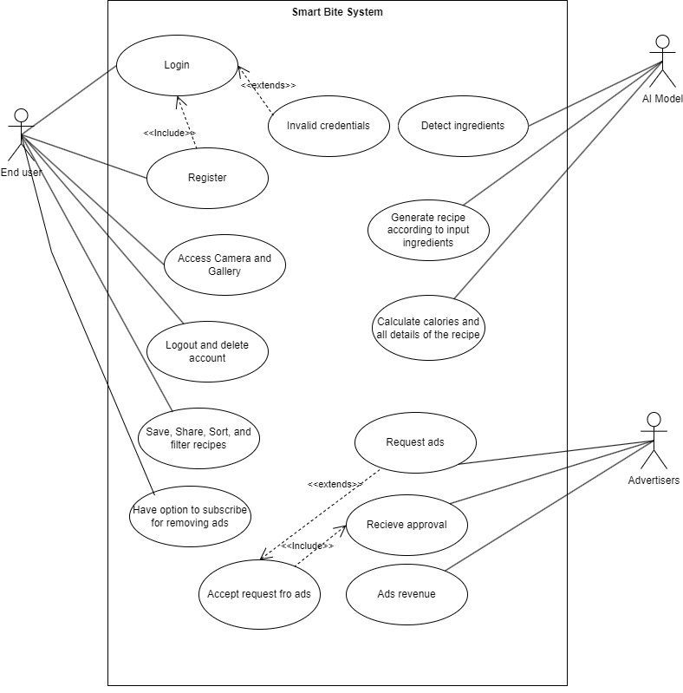
Use Case Model

Slide 5
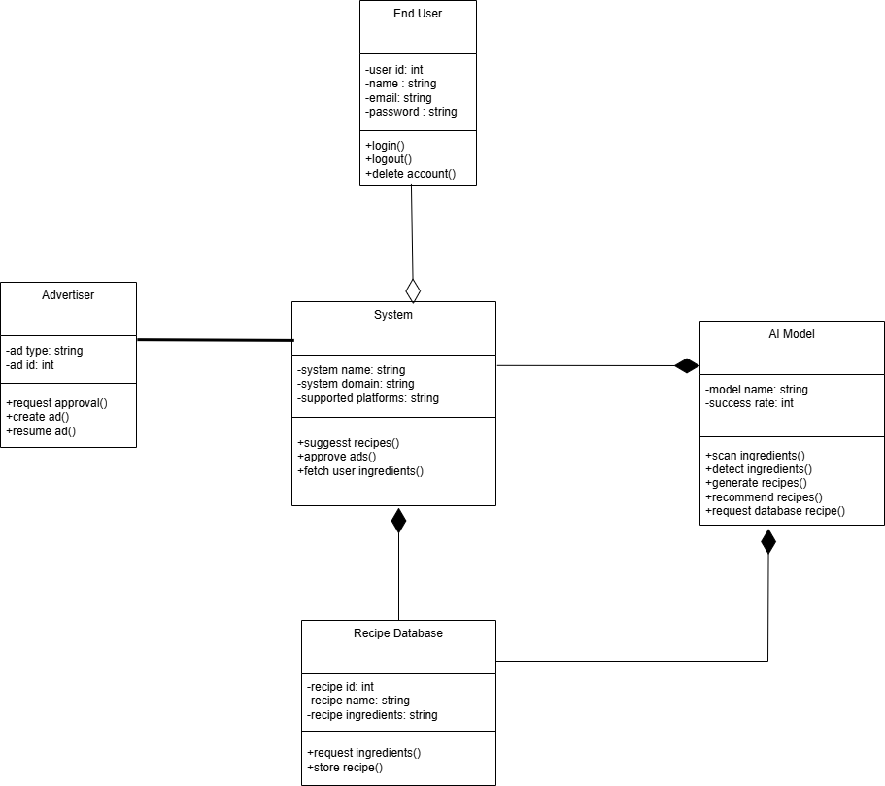
Domain Model

Slide 6
Key Requirements
FR-06, The AI photo scanner should generate recipes, High priority
FR-07, The System should show detail of recipes, Medium Priority
NFR-02, Performance, The AI recipe generation must be under 10 seconds.
NFR-08, Scalability, The System should be able to withstand 5000 Users at once.
NFR-09, Usability, Interface must be consistent, Modern and easy to understand.

Slide 7
Story Board

Slide 8
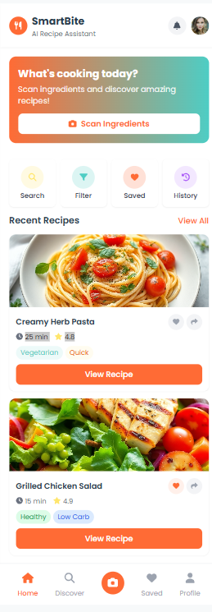

Slide 9
Change request
CR Number: CR-01 Requested By: SmartBite Team Date: 02/12/2025
Description of Change: Update the recipe screen layout to make the ingredients and steps easier to read.
Reason for Change: Users mentioned in the questionnaire that step-by-step instructions and clear ingredient lists are important (Q3). Improving layout increases usability.
Impact Analysis:
• Affected Requirements:
FR-1: Personalized recipe display
FR-2: Recipe saving and viewing
Affected Diagrams:
UI mockups (only visual changes)
No changes to use cases
Risks:
Minor delay in UI design updates
No technical risks
Approved?
☐ Yes
☑ No
Updated SRS Version: Version 1.0.1

Slide 10
Conclusion
Smart Bite offers a practical and intelligent solution to everyday cooking challenges by transforming available ingredients into healthy, affordable, and easy-to-follow recipes. Through AI-powered ingredient detection and personalized meal generation, the app helps users save time, reduce food waste, and make smarter nutrition choices. Designed for students, families, and busy individuals, Smart Bite makes cooking simpler, more efficient, and more accessible—turning the question “What should I cook?” into instant, confidence-boosting answers.

Slide 11
Thank you!

